Slide 1
Predicting Future Claims

Slide 2



Extended Warranties & Claims
Some business context
When a customer buys an item they are often given an option to buy an extended warranty beyond the OEM warranty (typically one year) that comes with the item - Sale.
If a customer pays for an extended warranty they may have coverage of that warranty for the next 2 to 5 years depending on the offering and selection - active warranty.
There maybe an option to cover accidental damage at the time of sale.
If an item malfunctions (or is accidentally broken) during the warranty a customer may reach out to the extended warranty company to get the item repaired or replaced - claim.
The company evaluates if the claim is covered and if found to be under the warranty and covered then they repair, replace or payout the item.
From the company’s point of view predicting claims is a crucial part.

Slide 3


Problem Context: Predict Claims
What do we know:
-Sales: the company knows has historical data and future assumptions about Sales.
-Active warranties: we also exactly know when an extended warranty was bought and when it’s going to expire hence we can calculate the number of Active Warranties the company is responsible for in any given month.
What we don’t know:
-Claims: We don’t know when an item is going to break or malfunction.
So we want to be able to accurately predict how many claims we are going to have in a future month so that the company can plan accordingly. We chose to predict the next six months.
This drives a lot of the company’s financials as well as operational planning. So it’s critically important to get this as accurate as possible.

Slide 4
Data Collection & Preparation
-The particular dataset was collected from a company’s actual database through running queries in SQL.
-ETL processes behind the scene made sure that we didn’t have to do much cleaning of the data.
-We have aggregated the data by month going from January of 2017 to September of 2021. We will try to forecast the next 6 months.
-We choose our validation data to be 6 months since we are predicting 6 months out. Also, we wanted our training data to be larger.

Slide 5
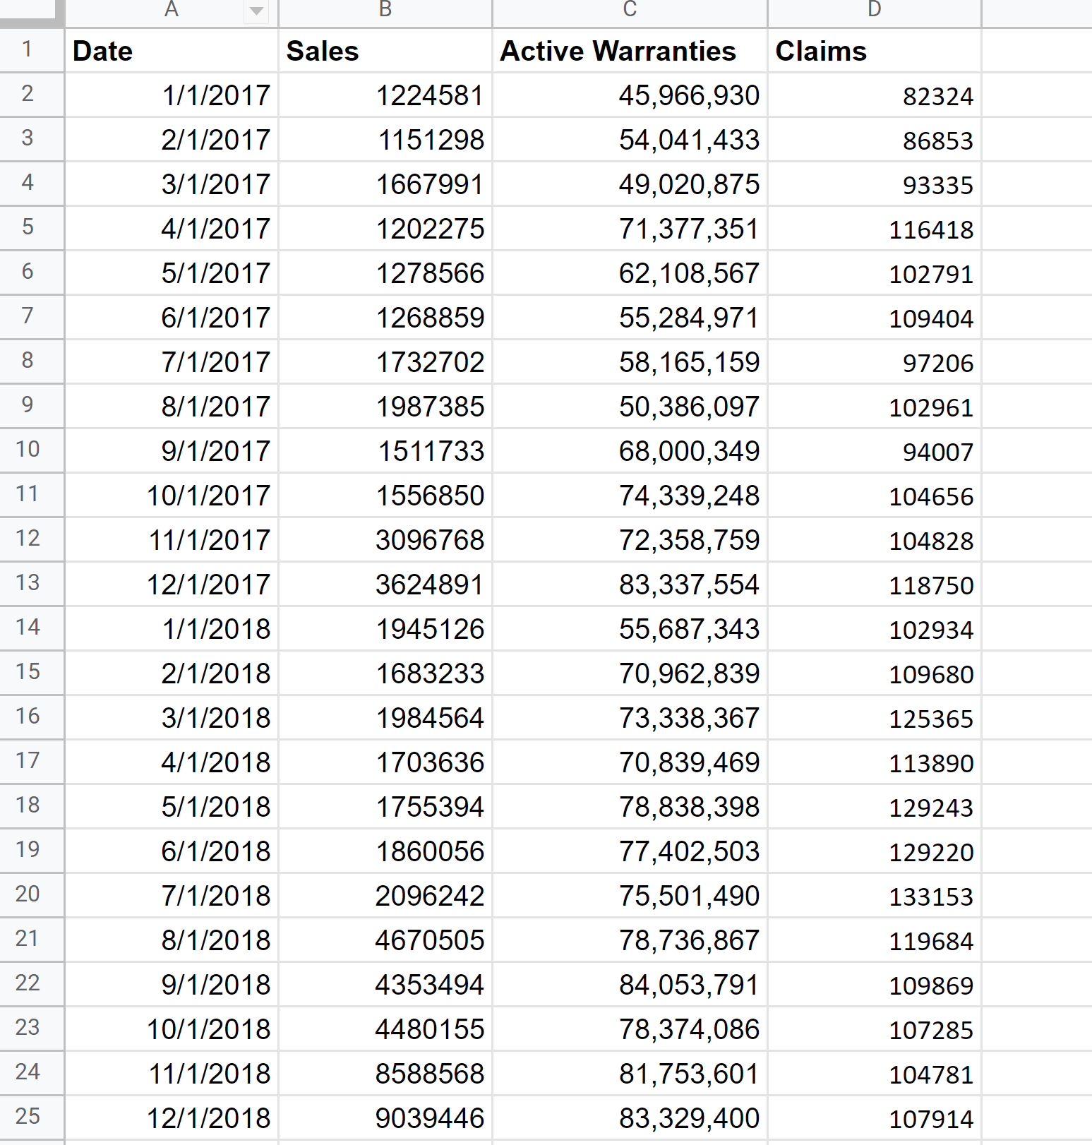
Data Sample

Slide 6
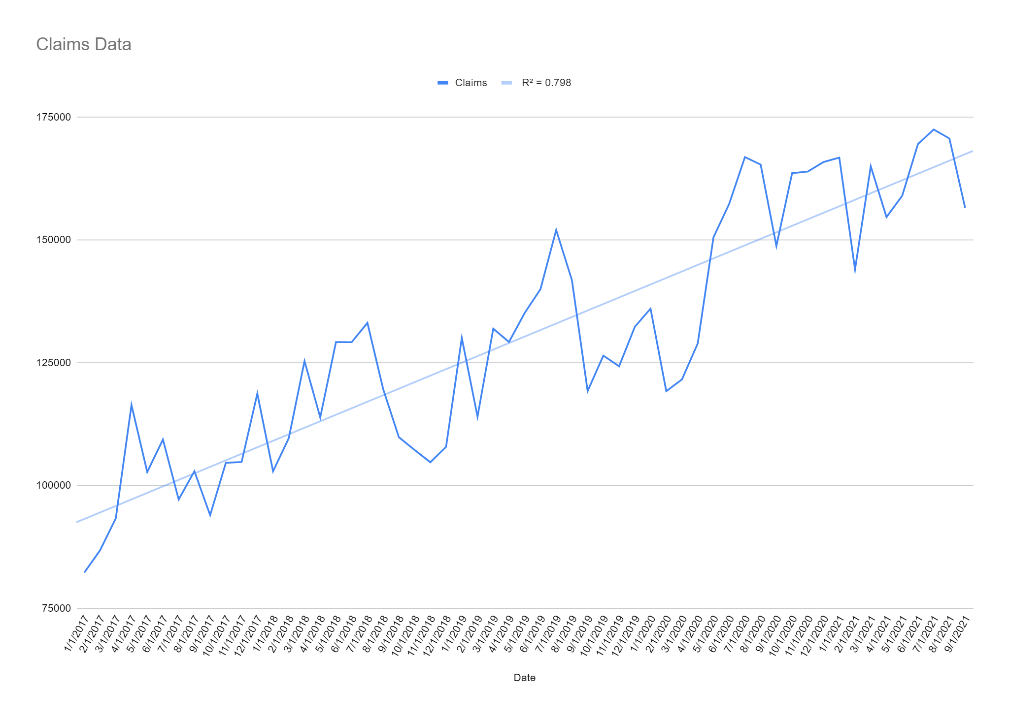
Data Trends: Claims

Slide 7
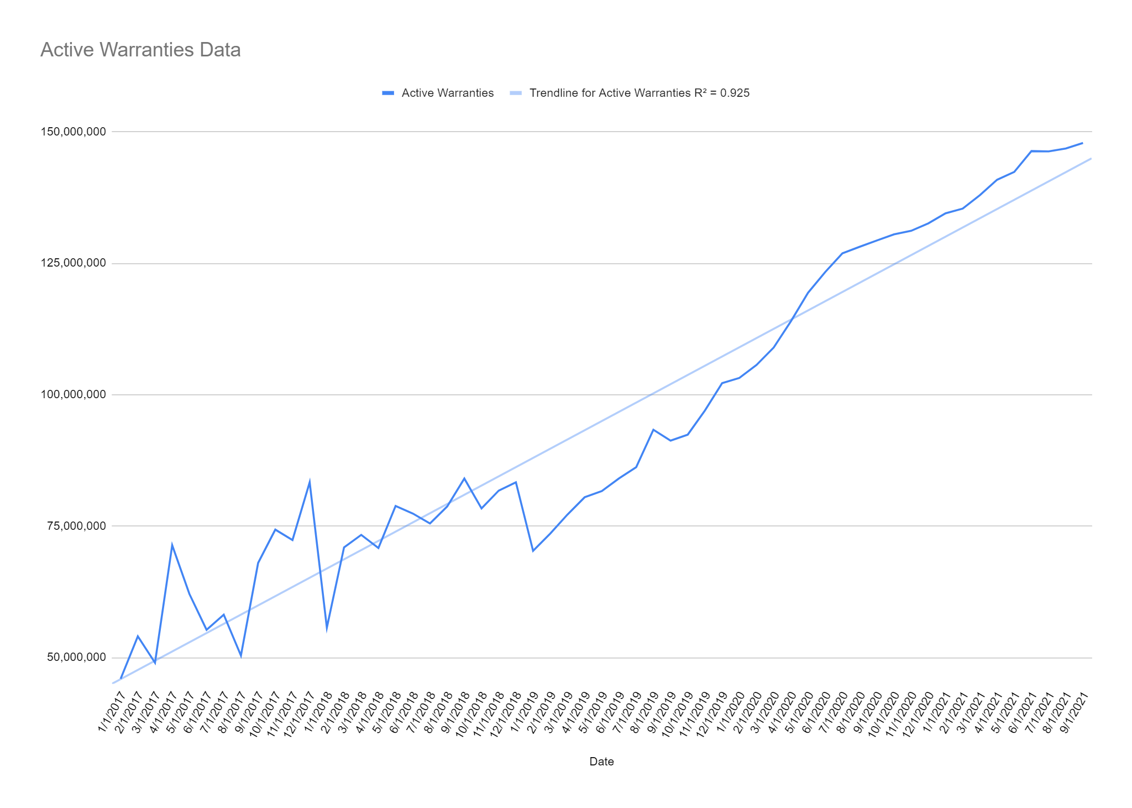
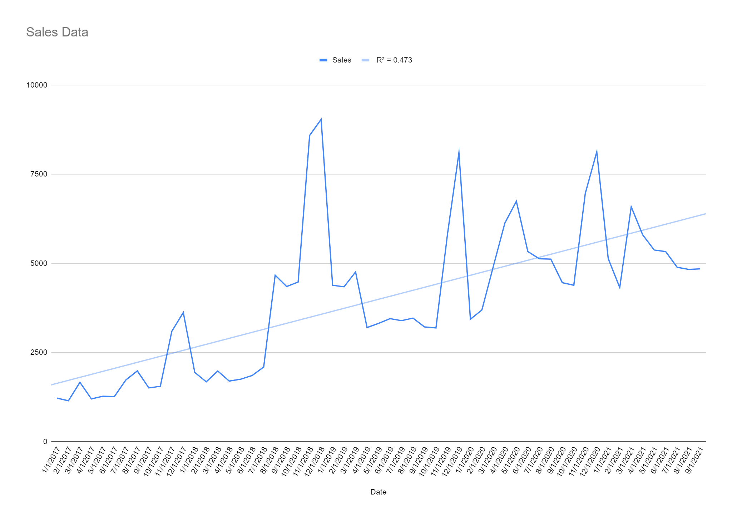
Data Trends: Active Warranties & Sales

Slide 8
Modeling methods & Accuracy methods
Since we are trying to predict the number of claims in the future we choose two modeling methods for this:
MVR : This method involves creating a regression model between Claims and the other variables.
K-NN: We treat Claims as a time series and run a K-NN regression.
Accuracy: For comparisons between our models we have chosen to go with Root Mean Squared Error (RMSE) and Mean Absolute Percentage Error (MAPE). These are the performance KPIs that will be used to decide our final model, especially MAPE.

Slide 9
Forecasting Method 1: MVR
-Fundamentally speaking Active Warranties would scale with Sales with respective to the mix of the terms of respective warranties sold.
-MODEL: MVR = lm(Claims ~ Sales + Active.Warranties, data=train.data)
-Train and Validation mix was 90/10, respectively.
Accuracy Metrics:

Slide 10
Forecasting Method 2: K-NN with Time Series Regression
-Since we are predicting the number of Claims a time series is created with just claims.
-Training and Validation split is 52 to 6 records, respectively
MODEL:
knn_forecasting(ts(train2.data), h = 6, lags = 1:6, k = 10, transform = "additive")
Accuracy:

Slide 11
Comparison & Result
MVR Accuracy Metrics:
K-NN with Time Series Accuracy Metrics:
Clearly, we can see that the K-NN model has the lower RMSE and MAPE. In fact an MAPE of lower than 5% is considered very good.

Slide 12
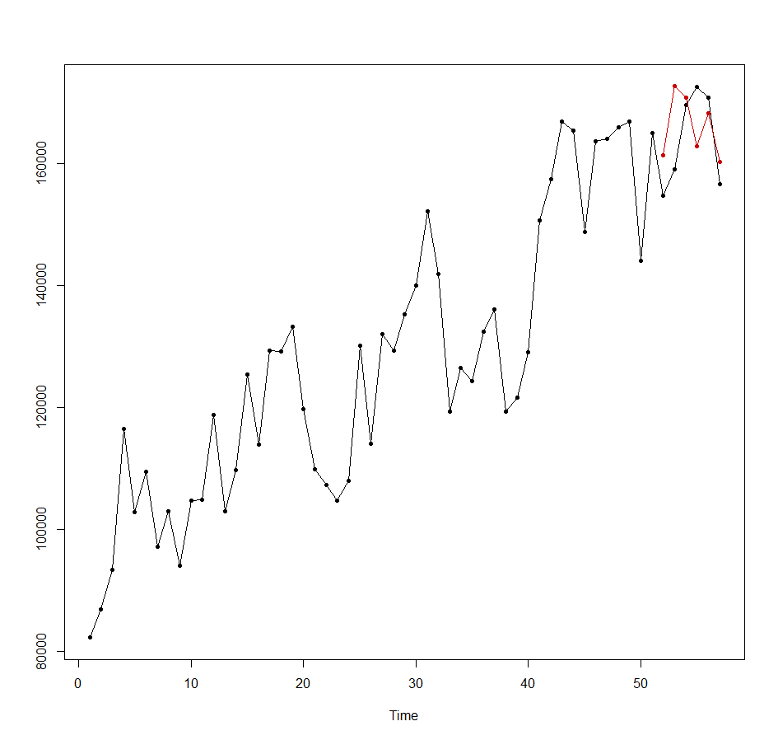

Predictions for six months - backtested
MODEL : pred.final =
knn_forecasting(ts(final.df), h = 6, lags = 1:6, k = 4, transform = "additive")
Accuracy:
As we can see that by successively moving and updating the forecast we get a much better results

Slide 13
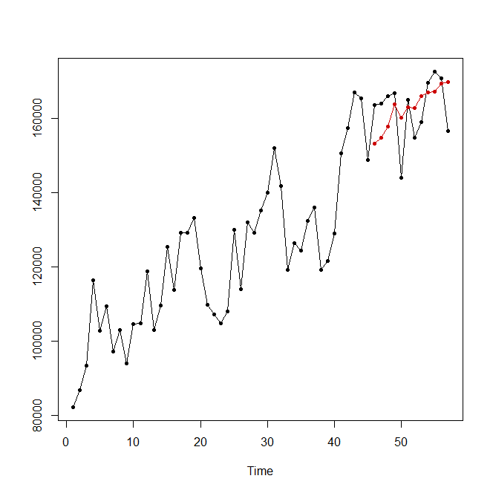

Predictions for twelve months - backtested
MODEL : pred.final =
knn_forecasting(ts(final.df), h = 12, lags = 1:6, k = 13, transform = "additive")
Accuracy:
The twelve month forecast is slightly less accurate than the six month forecast, which makes sense.

Slide 14
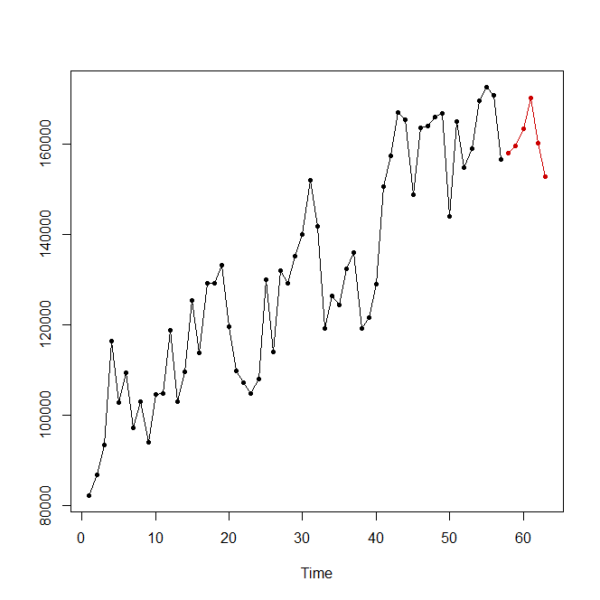
Recommendations
-Forecast Claims Using the time series with K-NN model for the next six months.
-Make rolling updates to the model each month with the new data point.
Current Six Month Rolling Predictions:

Slide 15
Final Predictions - 6 months
Our best model predicts:
1.October 2021: 157,969
2. November 2021: 159,571
3. December 2021: 163,417
4. January 2022: 170,199
5. February 2022: 160,107
6. March 2022: 152,813

Slide 16
Conclusion
-Our dataset had values for Sales of Plans, no. of active warranties and historical claims per month.
-We wanted to figure out the best way to predict how many claims we would get each month for the next six months.
-We were able to test two methods - MVR & Time Series with K-NN.
-From our tests we could tell that our model performs better at predicting shorter time frames like 6 months and the accuracy decreases if we want to predict out to 12 months or beyond.
-Our K-NN model when backtested results in an MAPE of less than 5% when forecasting for the next six months but the accuracy decreases if we predict longer time frames.

